Slide 1
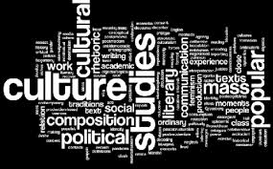
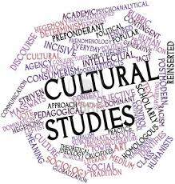
CULTURAL STUDIES AND MULTICULTURALISM

Slide 2
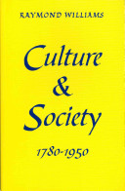
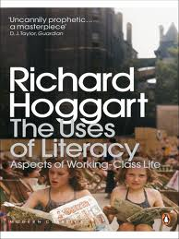
CULTURAL STUDIES AND MULTICULTURALISM

Slide 3
CULTURAL STUDIES AND MULTICULTURALISM
The problem of cultural studies is the difficult task of both acknowledging cultural and human differences and discovering means of creating culture and community where whatever people share with one another is not lost in acknowledged difference. In relation to literary criticism, the problem of cultural studies is the difficulty of linking literary and cultural works out of the neglect and secondaryness to which for all kinds of political and ideological reasons they had been condemned. Davis and Schleifer, Contemporary Literary Theory. Literary and Cultural Studies, 1994, p.599.

Slide 4
CULTURAL STUDIES AND MULTICULTURALISM
Cultural studies is an interdisciplinary, transdisciplinary, and sometimes counter-disciplinary field that operates in the tension between its tendencies to embrace both a broad, anthropological and more narrowly humanistic conception of culture. Unlike traditional anthropology, however, it has grown out of analyses of modern industrial societies. It is typically interpretative and evaluative in its methodologies, but unlike traditional humanism it rejects the exclusive equation of culture with high culture and argues that all forms of cultural production need to be studied in relation to other cultural practises and to social and historical structures. Cultural studies need to be studied in relation to other cultural practises and to social and historical structures. Cultural studies is thus committed to the study of the entire range of a society’s arts” Grossberg, Nelson. Trichler, Cultural Studies, 1992, p. 4.

Slide 5
CULTURAL STUDIES AND MULTICULTURALISM
became a noun of ‘inner’ process, specialized to its presumed agencies in ‘intellectual life’ and ‘the arts’. It became also a noun of general process, specialized to its presumed configurations in ‘whole ways of life’. It played a crucial role in definitions of ‘the arts’ and ‘the humanities’, from the first sense. It played an equally crucial role in definitions of the ‘human sciences’ and the ‘social sciences’ in the second sense. Each tendency is ready to deny any proper use of the concept to the other, in spite of many attempts at reconciliation.
Raymond Williams, Marxism and Literature, p. 17

Slide 6
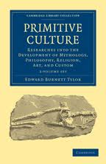
CULTURAL STUDIES AND MULTICULTURALISM

Slide 7
CULTURAL STUDIES AND MULTICULTURALISM
Stuart Hall in “Cultural Studies:two Paradigms” (1980)
fase culturalista
fase strutturalista
Fase post-strutturalista o fase cultural-materialista

Slide 8
CULTURAL STUDIES AND MULTICULTURALISM
Richard Hoggart The Uses of Literacy (1957), Raymond Williams Culture and Society (1958), E.R. Thompson The Making of The English Working Class (1963)

Slide 9
CULTURAL STUDIES AND MULTICULTURALISM
Claude Lévi-Strauss, Anthropologie structurale (1958)
Anthropologie structurale II (1972)
Mythologiques I. Le cru et le cuit (1964)
Mythologiques II. Du miel aux cendres (1967)
Mythologiques III. L'origine des manières de table (1968)
Mythologiques IV. L'homme nu (1971)

Slide 10

CULTURAL STUDIES AND MULTICULTURALISM
Roland Barthes, Mythologies (1957)

Slide 11

CULTURAL STUDIES AND MULTICULTURALISM
Michel Foucault

Slide 12
CULTURAL STUDIES AND MULTICULTURALISM
Madness and Civilization (1961)
The Birth of the Clinic (1963)
The Order of Things (1966)
Discipline and Punish (1975)
History of Sexuality (1976)

Slide 13
CULTURAL STUDIES AND MULTICULTURALISM
FRANTZ FANON
Peau Noire, Masques Blancs (1952)
Les Damnés de la Terre (1961)

Slide 14
CULTURAL STUDIES AND MULTICULTURALISM
Bill Ashcroft, Gareth Griffiths e Helen Tiffin, che “The Empire Writes Back” (1989)
Edward Said, Orientalism (1978)
Gayatri Spivak , "Can The Subaltern Speak?”
H.K. Bhabha The Location of Culture (1994),

Slide 15
CULTURAL STUDIES AND MULTICULTURALISM
Virginia Woolf “A Room of One’s Own” (1929)
Simone de Beauvoir, Le Deuxième Sexe (1949)

Slide 16
CULTURAL STUDIES AND MULTICULTURALISM
Germaine Greer The Female Eunuch (1970),
Eva Figes Patriarchal Attitues (1970)
Kate Millett Sexual Politics (1971)
Elaine Showalter A Literature of Their Own (1977)

Slide 17
CULTURAL STUDIES AND MULTICULTURALISM
Bashir Bashir, Will Kimlicka (eds.), The Politics of Reconciliation in Multicultural Societies (Oxford: Oxford University Press, 2008); Nathan Glazer, We are All Multiculturalist Now (Cambridge, MA: Harvard University Press, 1997); David Theo Goldberg, Multiculturalism: a Critical Reader (Oxford: Basil Blackwell, 1994); Amy Gutmann (ed.), Multiculturalism and the "Politics of Recognition" (Princeton: Princeton University Press, 1994); Will Kymlicka, Multicultural Citizenship: A Liberal Theory of Minority Rights (Oxford: Oxford University Press, 1995); Tariq Modood, Multicultural Politics: Racism, Ethnicity, and Muslims in Britain, Edinburgh and Minnesota (Edinburgh: Edinburgh University Press, 2005); Tariq Modood, Multiculturalism: a Civic Idea (Cambridge: Polity Press, 2007); Bhikhu Parekh, Rethinking Multiculturalism; Cultural Diversity and Political Theory (London and Cambridge, MA: Macmillan and Harvard University Press, 2000); Omid Payrow Shabani (ed.), Multiculturalism and Law: A Critical Debate (Cardiff: University of Wales Press, 2007); Charles Taylor (ed.), Multiculturalism (Princeton: Princeton University Press, 1994); Sienho Yee and Jacques-Yvan Morin (eds.), Multiculturalism and International Law (Leiden: Martinus Nijhoff Publishers, 2009).

Slide 18
CULTURAL STUDIES AND MULTICULTURALISM
It introduces into western nation-states a kind of ethno-religious mix that is relatively unusual for those states, especially for western European states [...] Secondly, it brings to bear notions of democratic citizenship and individual rights on the idea of a co-presence of ethnic and religious communities which goes well beyond the experience of pre-nation-state multiculturalism even if not necessarily approximating to the extent of institutionalized cultural plurality that was achieved by imperial states such as the Ottoman Empire.
Modood, Multiculturalism: a Civic Idea, 9.

